Slide 1
Drone IoT Client + Server System
By Arjun Tambe
arjun.m.tambe@ama-inc.com

Slide 2
Motivation
Many sensor applications must monitor large, remote areas with moderate sensing intervals, for multi-month durations
Air, water quality
Landslide, avalanche, or earthquake analysis
Forest fire risk monitoring
3 key challenges: (1) power, (2) data retrieval, and (3) cost/ease of deployment
Notes:
Large, remote area makes LoRa, WiFi impractical.
But moderate sensing intervals mean sensors must be stationed in the field, rather than flown in to take measurements occasionally.
3 challenges:
How do we get the sensor to survive in the field for months?
How do we retrieve data from the sensor when it’s in the field?
How do we make this system cheap and easy to deploy?

Slide 3



Solution: Key features
Power: Sensor “sleeps” when inactive
Achieves low enough power to live 8 weeks on a single watch battery
Data retrieval: only transmit when “triggered” by collector
No need to schedule collections/flyovers
Data collector uploads data to the server
Cost, ease of deployment:
At high volumes, $3 each
Drones already used for image collection

Slide 4
Additional “bonus” features
Open-source, end-to-end system, from PCB layout to server
Easy to add/exchange sensors to fit various use cases
“Desktop WiFi Mode:” sensor deployed indoors, connects to WiFi network directly, includes a display
Notes:
Sensors use I2C, so it’s easy to pick and swap out another I2C sensor

Slide 5
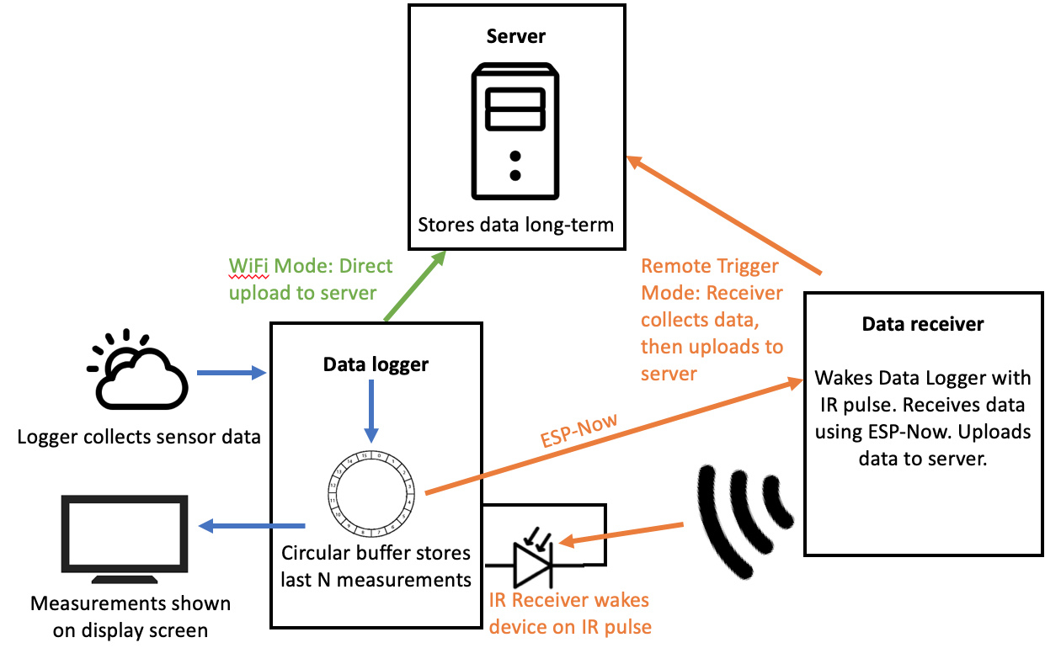
Notional Diagram

Slide 6
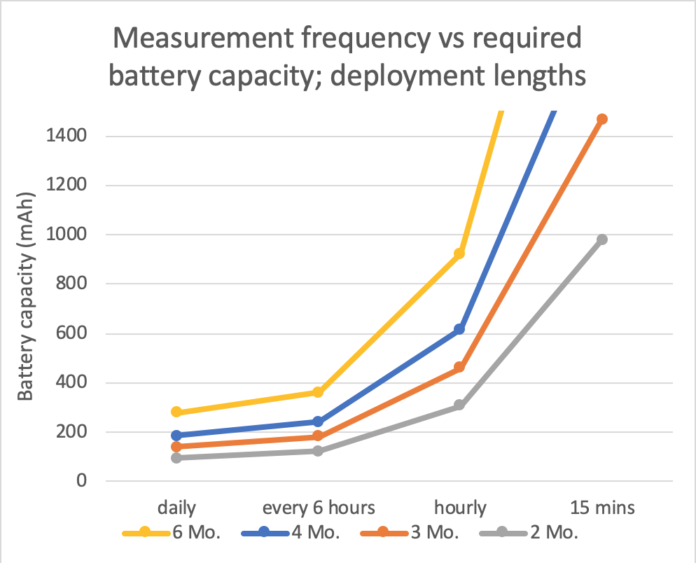
Key feature 1: Low power consumption
10uA power consumption in sleep
ADCs, RF module, etc all powered down
4 kB RTC memory stays powered on for data, state tracking
Wake from timer (configurable duration) or trigger interrupt
120mAh battery: tiny coin cell
1000mAh: AAA/card size LiPo
Notes:
Assumptions made in this chart are conservative:
--Sensor spends 1 minute transmitting, once per week (typically closer to 10 seconds)
--Device takes 15 seconds to power on, read sensors, and sleep (typically under 10 seconds)
--Hardware peripherals require 20mA power when sensing
--Hardware peripherals require 40uA power when sleeping
--Device requires 20mA power when sensing (in datasheet)
--Device requires 10uA power when sleeping (in datasheet)

Slide 7
Key feature 2: Remote Trigger
Trigger signal drives a pin high, wakes device
Device sends data, then returns to sleep
Current: IR Trigger
High-pass filter with 38 kHz modulated trigger signal
Requires line-of-sight, no direct sunlight
30+ ft range, can be extended with higher-power LEDs
RF trigger solutions
12uA power consumption for RF chip
Minimize spurious wakeup signals
Notes:
The RF solution has not yet been implemented, but a few recent papers dedicated to it have shown strong results that we should be able to replicate.
See:
Galante-Sempere, D., et al. (2020). “Low-Power RFED Wake-Up Receiver Design for Low-Cost Wireless Sensor Network Applications.” Sensors 2020.
Hoflinger, F., et al. (2018). “Localization System based on Ultra Low-power Radio Landmarks.” SENSORNETS 2018.
Kaushik, K., et al. (2016). “Low-cost Wake-up Receiver for RF Energy Harvesting Wireless Sensor Networks.” IEEE Sensors Journal.

Slide 8
Key feature 3: Circular data buffer
Goal: maximize storage efficiency
2-byte struct: doubles storage, preserves resolution
Min-value + value*resolution: 65,000 increments from max to min
Easy to change to accommodate 2-byte floats, etc.
Overhead: 8 bytes metadata per 1000 bytes of data
2 floats: min value, resolution
Notes:
We only have 4 kB for possibly many different kinds of measurements!
A week’s worth of data, with hourly readings from 5 sensors, is over 800 measurements.
This min-value + value*resolution treats the 2 bytes as a 16-bit integer, but improves the resolution (and captures fractional values), at the cost of the overhead of having to specify a min value and resolution.
To change the protocol you just have to change two functions in the receiver and sender.

Slide 9
Key feature 4: Timing
Time data as bulky as data itself!
However, wakeup cycles are regular
So, just send the interval in metadata; align with an “offset”
Leave gaps when fail to collect data
The collector (accurately) measures the real time
WiFi, GPS time, etc
Interval:
900 sec.
Interval:
900 sec.
Interval:
900 sec.
Offset:
300 sec.
Receiver clock:
4/7/2021 6:16:59.121 PM UTC
41%
39%
NaN
42%
Humidity data buffer
Notes:
What if wakeup cycles are irregular, and they’re not equal to what is specified in the interval? Unfortunately, recording the RTC time won’t help with this.
The device wakes up whenever the RTC says 15 minutes have expired. If that doesn’t match with an actual 15 minutes, it’s because the RTC is running slow or fast. So it’s pointless to use the RTC to record how much time has actually expired. It’s like using a ruler to measure itself.
If the device loses power, all its memory is lost, so aligning the clock in the case of power loss is a non-issue. However, a by-product of this fact is that any data the Logger sends is guaranteed to be more or less accurately time-stamped.

Slide 10
Key feature 5: ESP-Now Transmissions (receiver)
MAC address + first 2 bytes: “Packet ID”
First packet from a new ID assumed to be metadata
Store metadata, use it to parse following packets from this ID
When buffer is full, treat next packet from same ID as metadata again
Sensor name: “abc”
Type: temperature
Min value: 0.0
“abc”, temperature…
0x02
First transmission from 0x02
Stored as metadata
0x02
Data: [25.2, 19.1…]
Space remaining: __ packet
0x02
0x1C42, 0x1F33…
Second transmission from 0x02 parsed with existing metadata
0x01
Sensor name: “def”
Type: humidity
Min value: 0.0
First transmission from 0x01
Stored as metadata
“def”, humidity…
0x01
Data: []
Space remaining: __ packet
0x02
0x1C42, 0x1F33…
Third transmission from 0x02
Parsed with existing metadata
Notes:
The sender just sends a metadata packet (following the preceding slide) and sends its entire data buffer(s) in however many packets are required to send it, in order. The order is important!
The fourth transmission in this example from 0x02:
The buffer is full. So the next packet is once again treated as metadata, overwriting the old metadata. The following set of packets will overwrite the buffer.

Slide 11
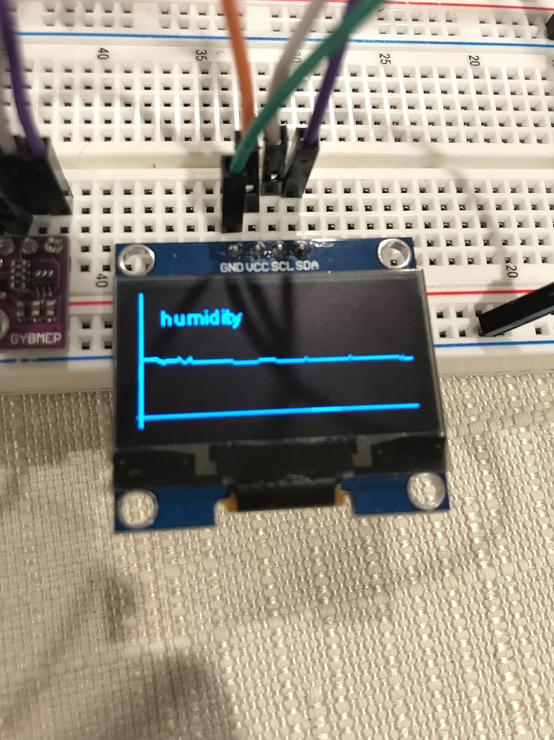
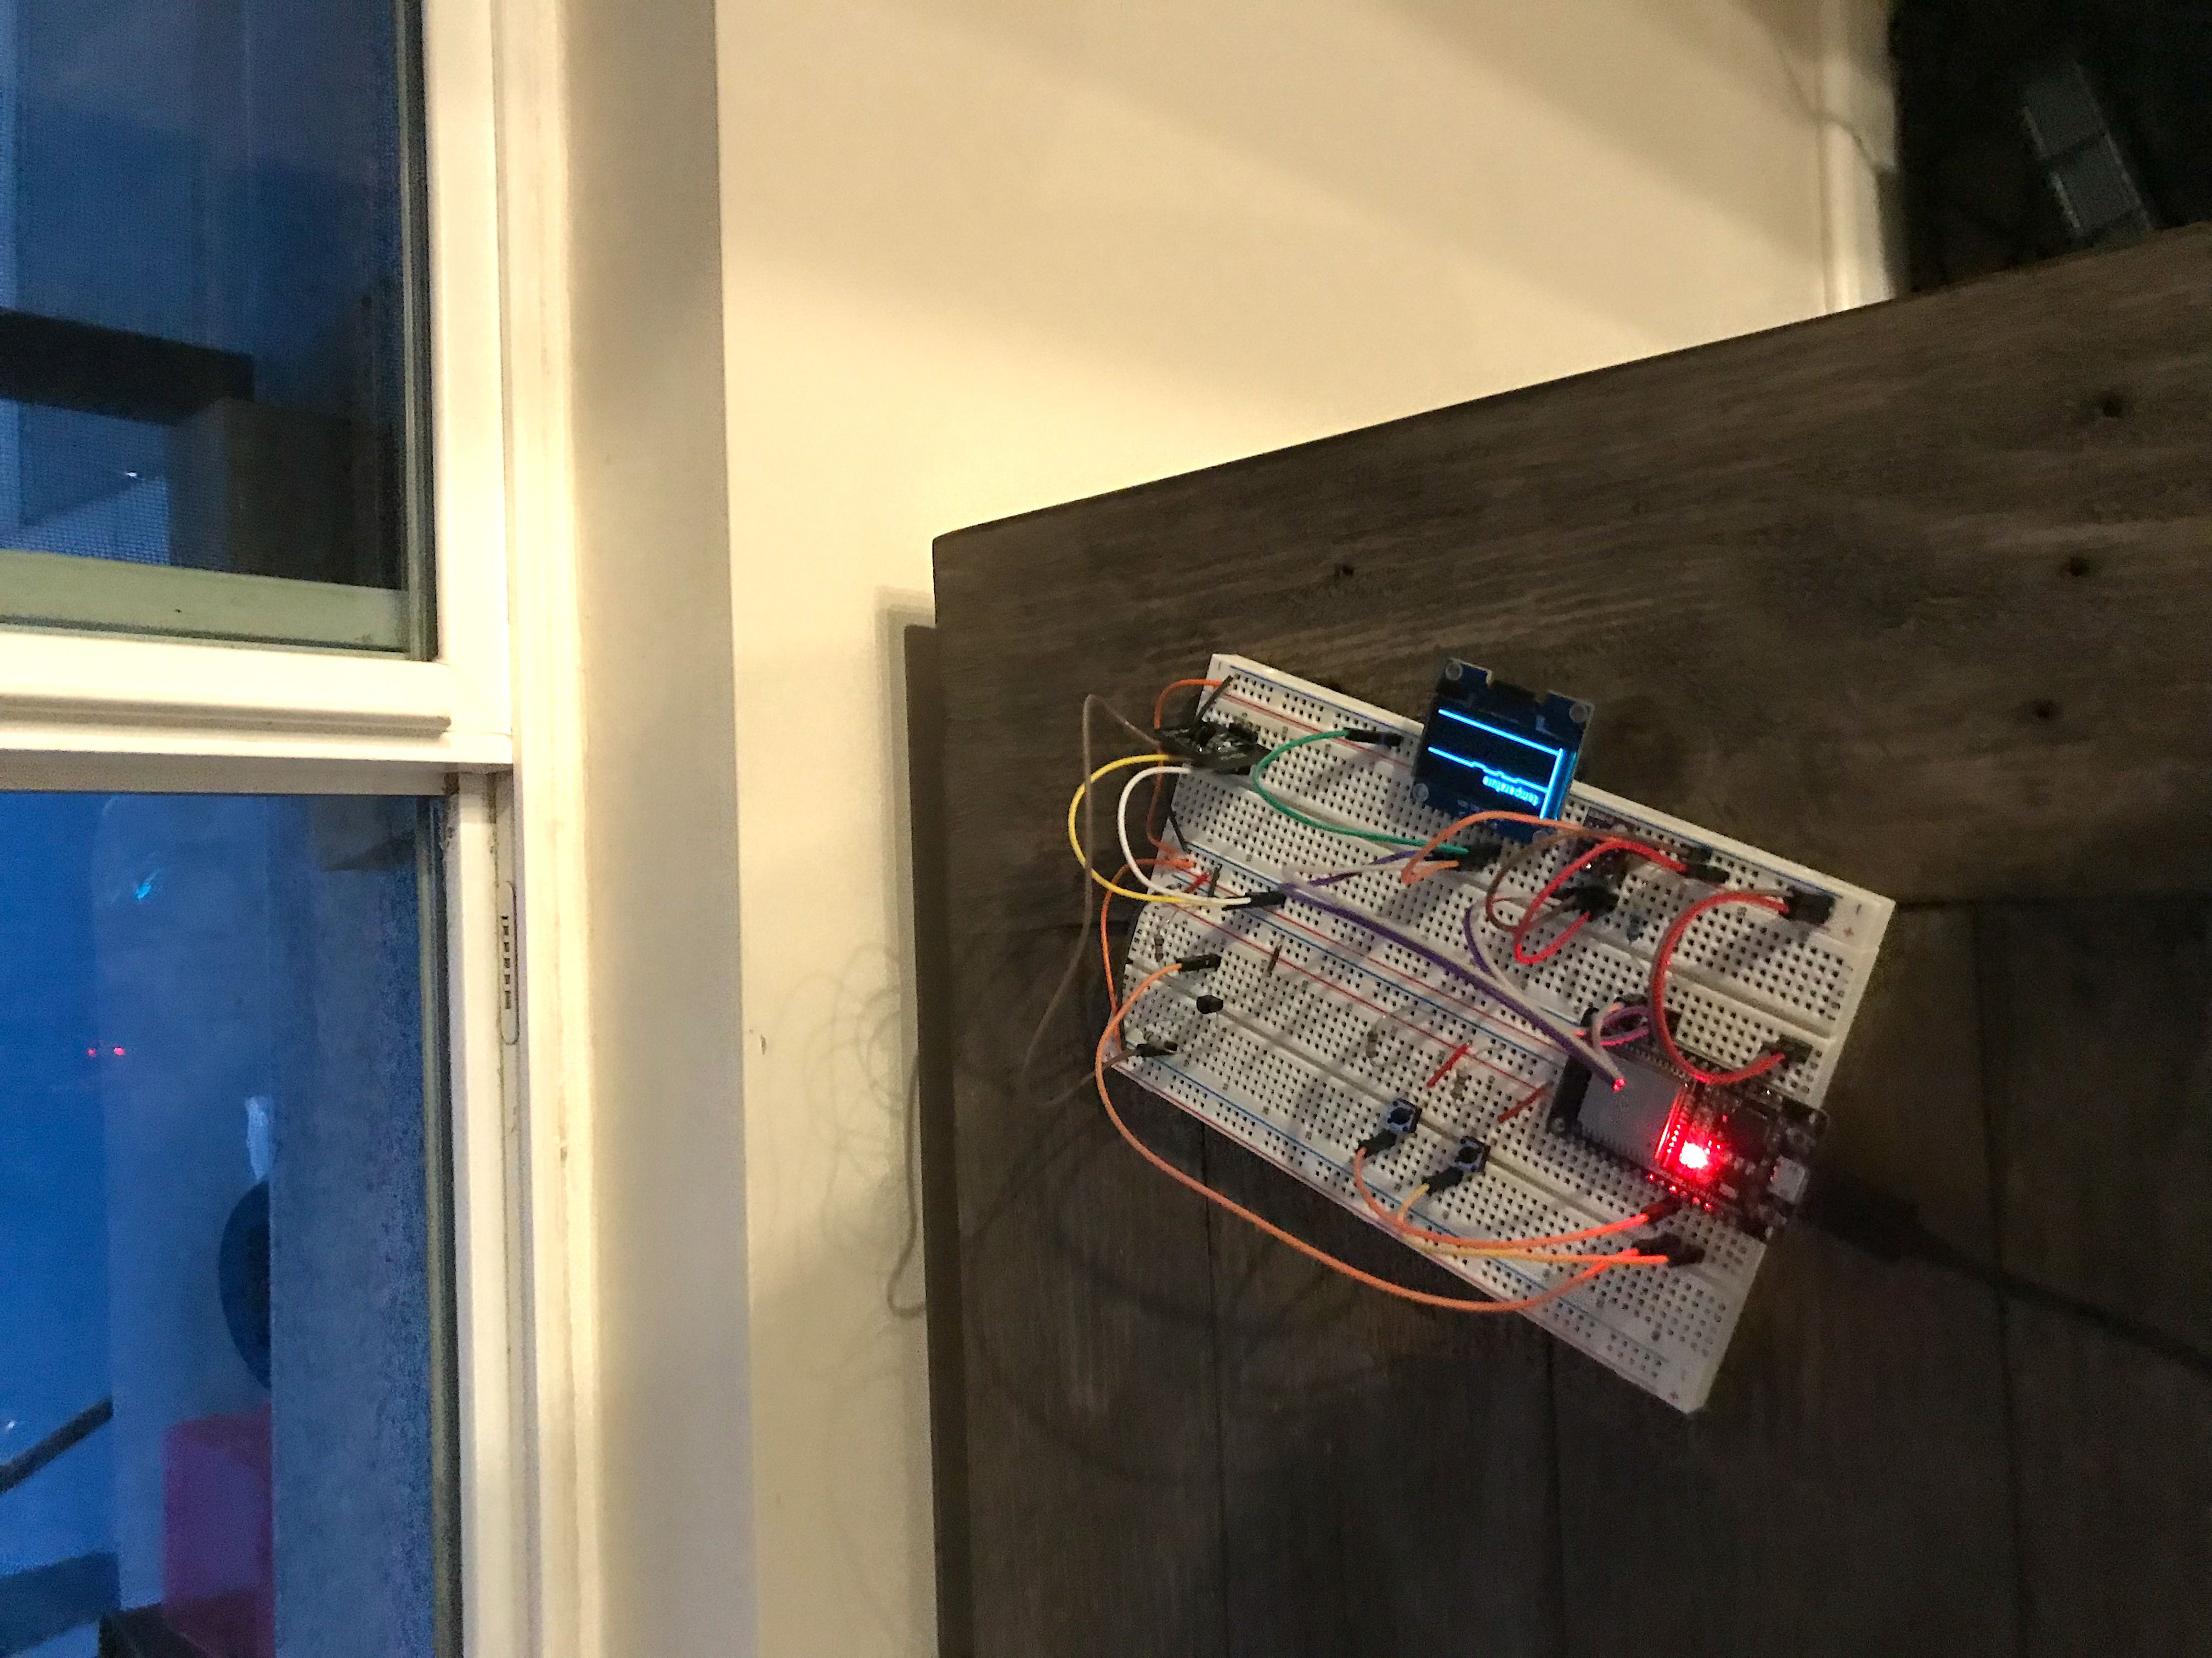
Additional feature 1: Desktop WiFi Mode
Device periodically wakes, connects to home WiFi network, uploads data, and displays data
OLED screen displays data buffer in graph

Slide 12
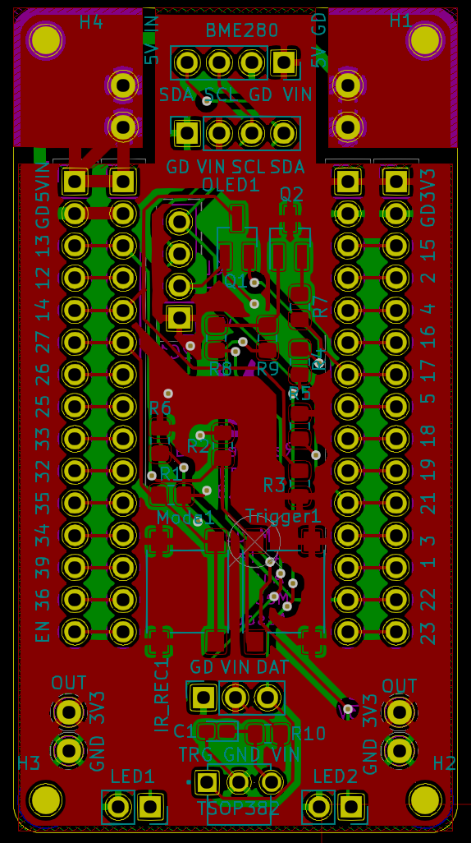
Additional feature 2: Open source
Whole system, end-to-end, is open-source
Includes tutorial doc, accessible to first-time Arduino users
Open-source PCB design
Eliminates need for wiring: snap all parts into header pins
GitHub repo for Data Logger and Collector
GitHub repo for Server
Integration with ODC in progress…

Slide 13
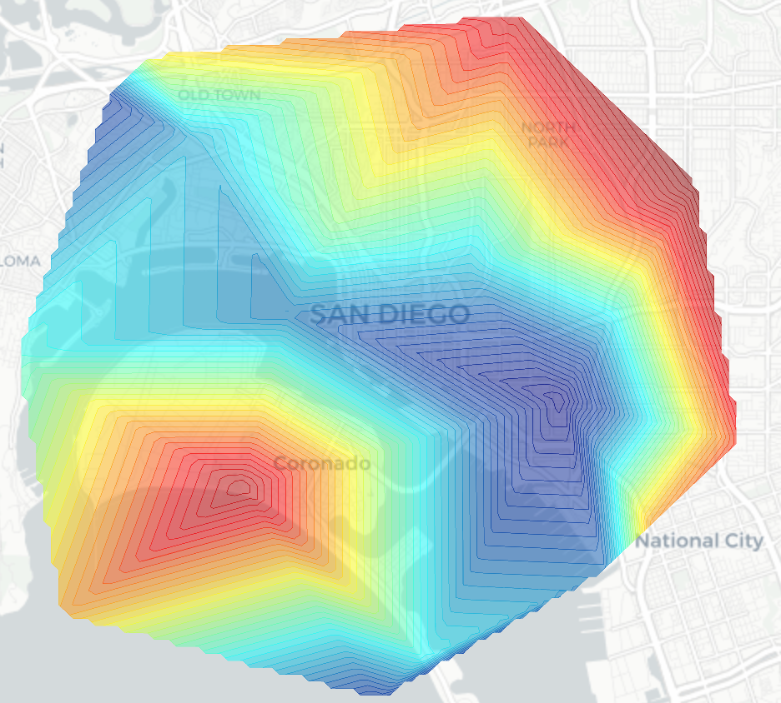
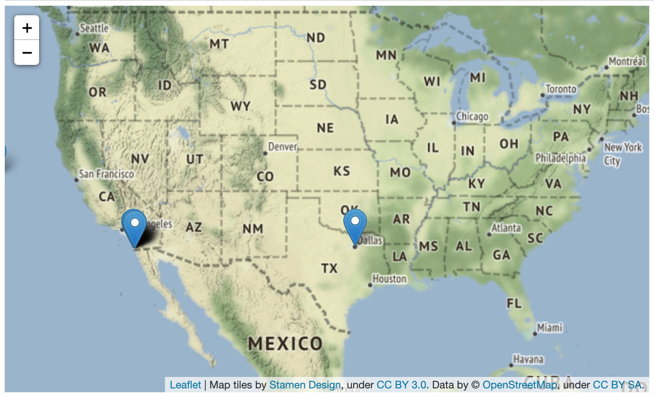
Server
Sensors can POST individually, or in large batches
Query sensor data by sensor ID, time, or coordinates
Possible to select/exclude data by known set of IDs
Open-source, easy to run out-of-the-box
Notes:
There is no authentication, but sensors have to include their “sensor name” when posting. It is possible to expand this in a way that allows us to include only a specific set of (e.g. registered or authenticated) users, by making the “sensor name” a secret key that is not public, but that users can provide the server to validate any measurements made with the secret key.

Slide 14
Future research
Additional power saving from hardware timer
nA-range power consumption; but requires non-volatile memory storage
RF triggering, instead of IR
Longer range, allows obstruction, allows full daylight
Waterproof data “buoys”
Enclosure; looser power and “drop” requirements; LoRa
Outdoor durability
Non-volatile memory for robustness to power failure
Resync RTC on flyovers, from daylight timing

